Slide 1


SSTIPEND: BUDGET TRACKER

Slide 2

PROBLEM STATEMENT
Scholars often struggle to manage their limited financial resources due to the lack of efficient tools for tracking expenses and monitoring their Pisay EVC Canteen Card balance. Manual methods are prone to errors and make budgeting difficult. The SStipend: Budget Tracker addresses this problem by automating expense tracking and balance monitoring. Through real-time updates and organized financial summaries, the app simplifies fund management, promotes financial responsibility, and supports informed decision-making among students.

Slide 3

PROJECT
OBJECTIVES:
To design a user-friendly interface that allows scholars to easily record and review their daily expenditures.
To automate the monitoring of the Pisay EVC Canteen Card balance and generate real-time updates.
To minimize human error in manual expense recording through the use of automation and digital computation.

Slide 4

PLANNED FEATURES:
1. ADD/CLEAR EXPENSE: This feature enables users to efficiently record their daily expenditures and manage their transaction data. By allowing students to add or clear expense entries, the system ensures accurate and up-to-date financial tracking.
2. BALANCE CHECKER: The balance checker provides real-time updates on the user’s remaining funds, reflecting transactions recorded within the application.
3. PURCHASE HISTORY: The purchase history feature systematically compiles all recorded transactions, allowing users to review their past spending activities over a selected period.
4. ADD MONEY TO BALANCE: Enables users to update their current funds and ensures that the recorded balance remains accurate and up to date.

Slide 5

The user will input their login pin to enable them access before our code outputs a menu and they are asked to make a choice. They could (1) add expense, (2) clear expense, (3) check purchase history, (4) check card balance, (5) add money to balance, or (6) exit the program. The user will then input the corresponding number of their choice and will be redirected back to the menu after going through the process of their respective choice. The program only ends once the user chooses to exit.
PLANNED INPUTS AND OUTPUTS:

Slide 6

example:
Menu:
[1] Add Expense
[2] Clear Last Expense
[3] Check History
[4] Check Card Balance
[5] Add Money
[6] Exit
Enter Choice: 3
No expenses to delete.
PLANNED INPUTS AND OUTPUTS:

Slide 7
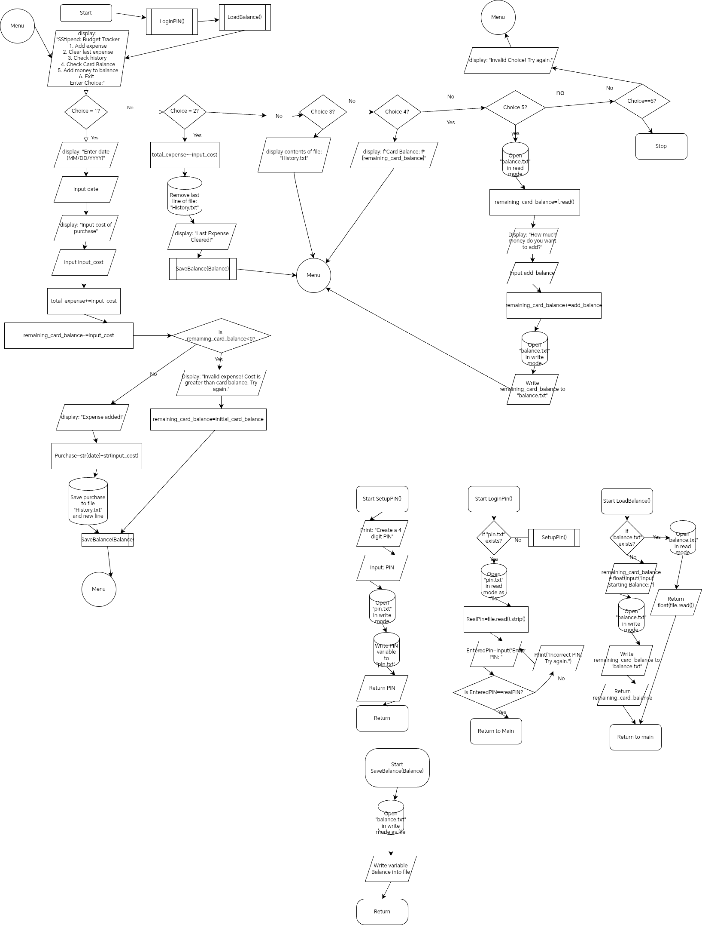

Slide 10


Slide 11

example:
Menu:
[1] Add Expense
[2] Clear Last Expense
[3] Check History
[4] Check Card Balance
[5] Add Money
[6] Exit
Enter Choice: 3
No expenses to delete.
PLANNED INPUTS AND OUTPUTS:

Slide 12
The user will input their login pin to enable them access before our code outputs a menu and they are asked to make a choice. They could (1) add expense, (2) clear expense, (3) check purchase history, (4) check card balance, (5) add money to balance, or (6) exit the program. The user will then input the corresponding number of their choice and will be redirected back to the menu after going through the process of their respective choice. The program only ends once the user chooses to exit.
PLANNED INPUTS AND OUTPUTS:

